Slide 1


Data Science Project: Data Analytics
Studying the accuracy and consistency of MLB umpires.

Slide 2
Problem Statement:
To analyze data found on umpires and determine how accurate or inaccurate they may or may not be.
Notes:
The Problem Statement. Why are you working on this project? I’m working on this project to determine how accurate and consistent umpires may or may not be, we will have to find out with these fascinating statistics. What is the benefit? To educate myself in learning how to analyze, interpret, and publish datasets in a fascinating way.
How annoying it is when an umpire sucks, completely sway games out of your favor, angel Hernandez is notorious awful umpire

Slide 3
The benefits of understanding this information are as follows:
I can now see what umpire is performing the worst.
How consistent an umpire might be throughout his series he conducts.
See how many of his calls are expected to be correct and which ones are correct.
The overall number of incorrect calls to expected incorrect calls.
Finally, total run impact that he has on the game’s runs.

Slide 4
Methodology

Slide 5

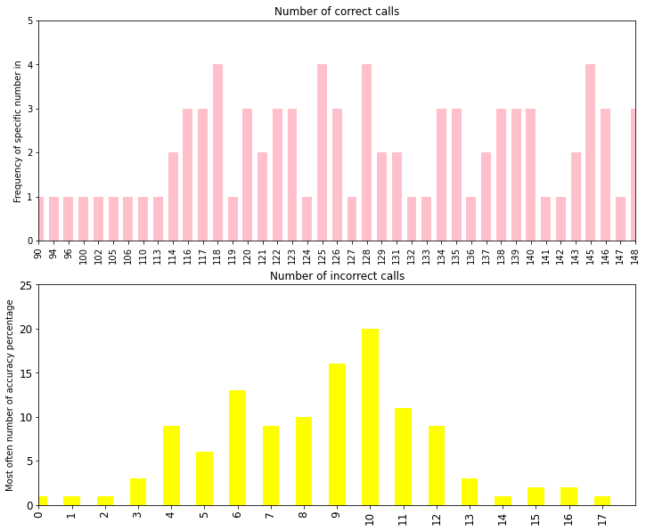

This graph compares the frequency of correct calls to incorrect calls in the month of October.

Slide 6
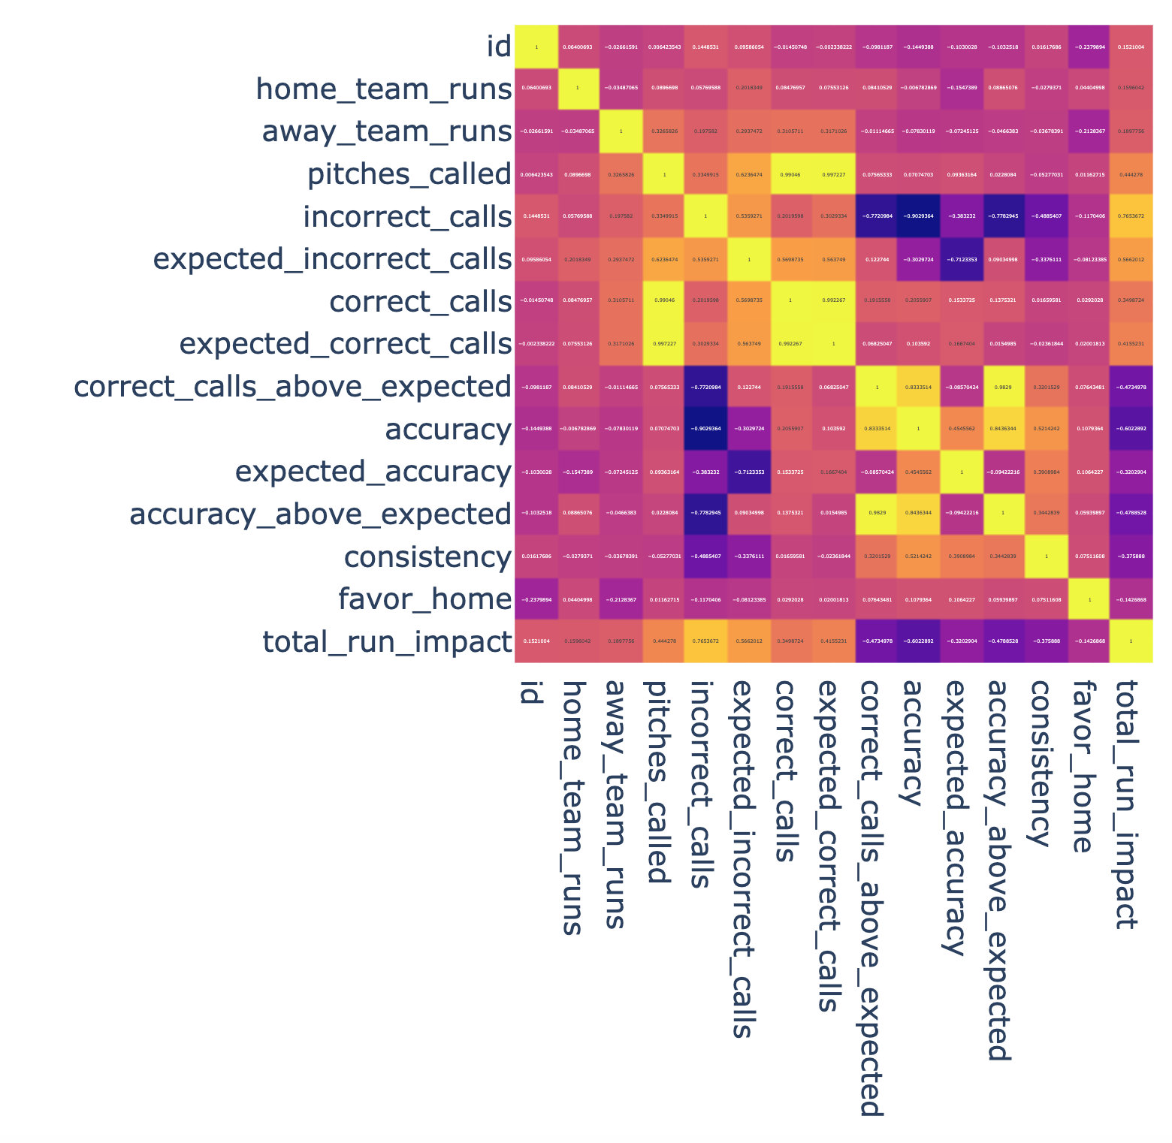

This is my generated heat map from the umpire dataset. In the key purple would be the lowest color represented and yellow would be the highest color. Through the center of the graph, I find it interesting that it’s shaped like a sword.

Slide 7
Findings
With the data found I noticed that certain umpires were shown for more than others.
Sometimes it’s easier said than done when you have an idea on what you what to analyze and show.
In the machine learning model, I hope to learn more about that in the future. I feel more behind in that area.
I felt like the easiest graphs to make and analyze were the bar graphs , hence why I used so much.

Slide 8
Future Work
A next step would be to learn more about how to become more efficient in data analytics
Learn and watch higher up people who work in this field
This data set could be revisited in the future, when I have more tools and knowledge to interpret the data in the ways I think of
With more work this dataset could 100% be improved by relating the two that I used to a neater and more usable way
More time would help, I could’ve done more research on how to implement machine learning models into my data analysis
Finding good instructional videos on coding in general are great options that I’ve used, and it helped me with this project a lot
Finally, I could’ve picked a dataset that pertains to more of a business rather than just data in baseball

